Slide 1
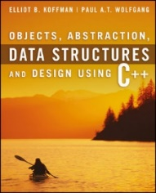
Welcome to
CS 235 Data Structures
Recursion, 7.3-4 (23)

Slide 2
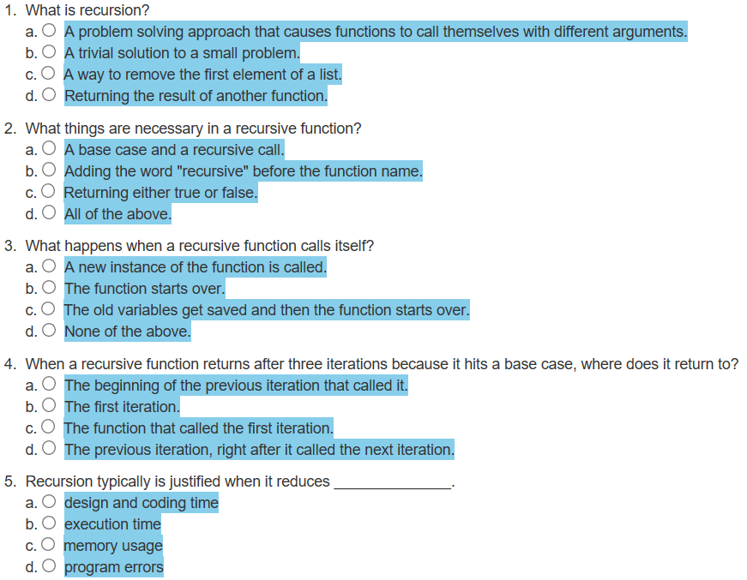
Attendance Quiz #22

Slide 3
Tip #23: Class or Function?
Its not about class or function - its about being able to write more efficient and reusable code in developing powerful apps what would be too complicated to write without classes.
OOP is generally about tying together state and behavior.
Classes group attributes (state) and behavior (methods) and asserting that only methods (encapsulation) can act on the state.
In OOP, the methods are responsible for implementing the behavior of the class.
The methods participate in the encapsulation of state (freeing clients from the implementation detail) and in the preservation of the class invariants (statements about the class state that hold true from its birth to its death).
Classes support polymorphism – the essence of OOP.
Using OO over functions or older styles in a larger program is for portability.
Easier, quicker, and more secure to pull out the information from a class.
For a beginner it may seem you don't need classes
for the little things, maybe…
But even fairly simple programs could be vastly improved with classes - serious projects almost can't happen without them.

Slide 4
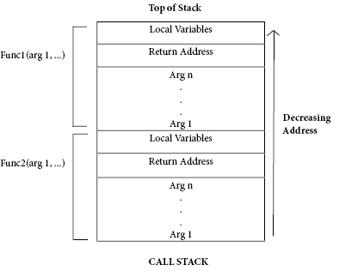
The Stack and Activation Frames
C++ maintains a stack on which it saves new information in the form of an activation frame.
The activation frame contains storage for
the return address of the calling function.
function arguments.
local variables (if any).
Whenever a new function is called (recursive or otherwise), C++ pushes a new activation frame onto the stack.

Slide 5
Tracing a Recursive Function
The process of returning from recursive calls and computing the partial results is called unwinding the recursion.
#include <iostream>
using namespace std;
int size(string str)
{
if (str == "") return 0;
return 1 + size(str.substr(1));
}
int main()
{
cout << size("ace");
return 0;
}
cout << size("ace");
3
return 1 + size("ce")
2
return 1 + size("e")
1
return 1 + size("")
0

Slide 6
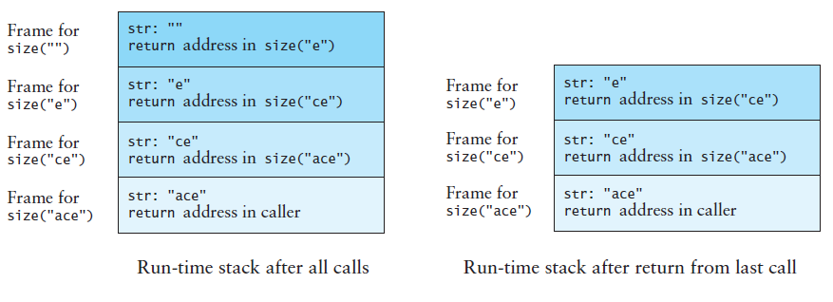
Run-Time Stack - Activation Frames
int main()
{
cout << size("ace");
return 0;
}
int size(string str)
{
if (str == "") return 0;
return size(str.substr(1));
}

Slide 7
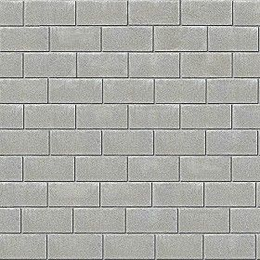
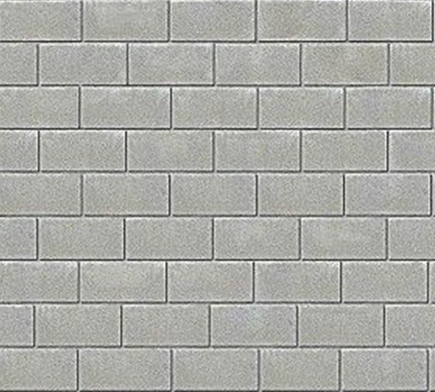
How To Build A 10-foot Wall?

Slide 8
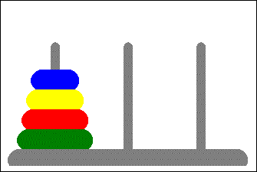
7.4 Problem Solving with Recursion
Case Study: Towers of Hanoi
Case Study: Counting Cells in a Blob
7.4, pgs. 426-434

Slide 9
Towers of Hanoi
Move the three disks to a different peg, maintaining their order (largest disk on bottom, smallest on top, etc.)
Only the top disk on a peg can be moved to another peg.
A larger disk cannot be placed on top of a smaller disk.
L M R
// recursive function to solve Tower of Hanoi puzzle
void move_disk(int disk, char from, char to, char temp)
{
if (disk == 1)
{
cout << "Move disk 1 from " << from << " to " << to << endl;
}
}
move_disk(4, 'L', 'R', 'M')
Move disk 1 from L to M
Move disk 2 from L to R
Move disk 1 from M to R
Move disk 3 from L to M
Move disk 1 from R to L
Move disk 2 from R to M
Move disk 1 from L to M
Move disk 4 from L to R
Move disk 1 from M to R
Move disk 2 from M to L
Move disk 1 from R to L
Move disk 3 from M to R
Move disk 1 from L to M
Move disk 2 from L to R
Move disk 1 from M to R
else
{
// move top disks (disks-1) to temporary peg.
move_disk(disk - 1, from, temp, to);
}
// move bottom disk to destination.
cout << "Move disk " << disk << " from " << from << " to " << to << endl;
// finish by moving temp disks on top of destination.
move_disk(disk - 1, temp, to, from);

Slide 10
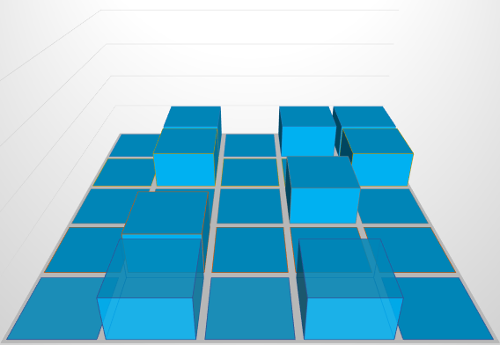
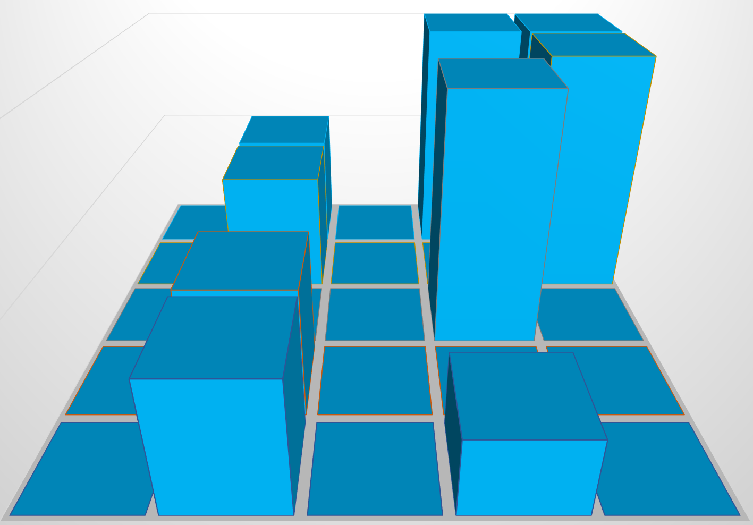
Counting Cells in a Blob
Consider how we might process an image that is presented as a two-dimensional grid of color values.
Information in the image may come from
Medical records (X-ray, MRI, death records, …)
Big data (NSA, Google, Facebook, …)
Satellite imagery
Shopping networks
Problem:
The goal is to determine the size of any area in the image that is considered abnormal because of its color values.
Given a two-dimensional grid of cells, each cell contains either a normal background color or a second color, which indicates the presence of an abnormality.
A blob is a collection of contiguous abnormal cells.
A user will enter the x, y coordinates of a cell in the blob, and the program will determine the count of all cells in that blob.

Slide 11
Count Cells in a Blob
#include <iostream>
using namespace std;
enum color { NORMAL, ABNORMAL, TEMPORARY };
const int ROW_SIZE = 5;
const int COL_SIZE = 5;
int cells(color[ROW_SIZE][COL_SIZE], int, int) { ... }
int main()
{
int row, col;
color grid[ROW_SIZE][COL_SIZE] = {
{ NORMAL, ABNORMAL, NORMAL, ABNORMAL, ABNORMAL },
{ NORMAL, ABNORMAL, NORMAL, NORMAL, ABNORMAL },
{ NORMAL, NORMAL, NORMAL, ABNORMAL, NORMAL},
{ NORMAL, ABNORMAL, NORMAL, NORMAL, NORMAL},
{ NORMAL, ABNORMAL, NORMAL, ABNORMAL, NORMAL} };
// Enter row and column of a cell in the blob
cout << "Enter row: "; std::cin >> row;
cout << "Enter column: "; std::cin >> col;
// Output cells in blob containing grid[row][col]
cout << cells(grid, row, col) << endl;
}

Slide 12
Count Cells in a Blob
/** Count number of blob cells that contains grid[r][c]
pre: Abnormal cells are in ABNORMAL color.
Other cells are in NORMAL color.
post: All cells in the blob are in TEMPORARY color.
@parm r The row of the blob cell
@parm c The column of a blob cell
@return The number of cells in the blob.
*/
int cells(color grid[ROW_SIZE][COL_SIZE], int r, int c)
{
if (r < 0 || r >= ROW_SIZE || c < 0 || c >= COL_SIZE) return 0;
if (grid[r][c] != ABNORMAL) return 0;
}
grid[r][c] = TEMPORARY;
int blob = 1;
blob += cells(grid, r-1, c-1) + cells(grid, r-1, c+0) + cells(grid, r-1, c+1);
blob += cells(grid, r+0, c-1) + cells(grid, r+0, c+1);
blob += cells(grid, r+1, c-1) + cells(grid, r+1, c+0) + cells(grid, r+1, c+1);
return blob;

Slide 13
Test Counting Cells in a Blob
Verify that the code works for the following cases:
A starting cell that is on the edge of the grid
A starting cell that has no neighboring abnormal cells
A starting cell whose only abnormal neighbor cells are diagonally connected to it
A "bull's-eye": a starting cell whose neighbors are all normal but their neighbors are abnormal
A starting cell that is normal
A grid that contains all abnormal cells
A grid that contains all normal cells
•
 |  | •
 |  | •
 |  | •
 |  | •

Slide 14
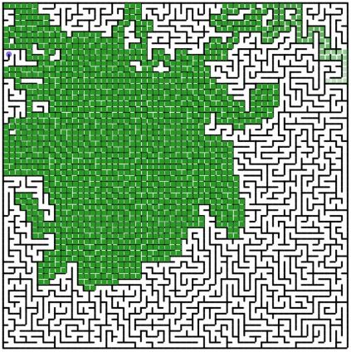
7.5 Backtracking
Case Study: Finding a Path Through a Maze
7.5, pgs. 435-440

Slide 15
Backtracking
Backtracking is an approach to implementing a systematic, non-repetitive, trial and error search for a solution to a maze.
As one encounters a path junction, a path is chosen.
Either you will reach your destination and exit the maze, or you won’t be able to go any farther.
If you can’t go any farther, you will need to consider alternative paths—you will need to backtrack until you reach a fork and follow a branch you did not travel hoping to reach your destination.
If you never try the same path more than once, you will eventually find a solution path if one exists.
Problems that are solved by backtracking can be described as a set of choices made by some function.
Recursion allows you to implement backtracking in a relatively straightforward manner.
Each activation frame is used to remember the choice that was made at that particular decision point.algorithm.

Slide 16
Finding a Path through a Maze
Problem
Use backtracking to find and display the path through a maze
From each point in a maze you can move to the next cell in a horizontal or vertical direction if the cell is not blocked.
Analysis
The maze will consist of an array of cells.
The starting point is at the top left corner maze[0][0].
The exit point is at the bottom right corner, that is
maze[ROW_SIZE - 1][COL_SIZE - 1].
All non-barrier cells will be OPEN color.
All cells that represent barriers will be BARRIER color.
Cells that we have visited will be VISITED color.
If we find a path, all cells on the path will be set to PATH color.

Slide 17
Design find_maze_path(x, y)
Out of Bounds?
Y
N
Open Path?
Visit
Neighbor
N
Return FALSE
Y
Path Found?
Return TRUE
Mark Cell as Path
Y
N
Maze Exit?
More
Neighbors?
Mark Cell as Visited
N
Y
N
Y
Return TRUE
Return FALSE
There is no attempt to find the shortest path through the maze.
We just mark the first path that is found.

Slide 18
Implementation
bool find_path(color maze[HEIGHT][WIDTH], int r, int c)
{
}
if ((r < 0) || (r >= HEIGHT) || (c < 0) || (c >= WIDTH))
return false; // Out of bounds, not path
if (maze[r][c] != OPEN)
return false; // Path blocked, not path
maze[r][c] = PATH; // Assume path
if ((r == HEIGHT - 1) && (c == WIDTH - 1))
return true; // Exit, success!
// Look for path above, left, right, below
if (find_path(maze, r - 1, c + 0)) return true;
if (find_path(maze, r + 0, c - 1)) return true;
if (find_path(maze, r + 0, c + 1)) return true;
if (find_path(maze, r + 1, c + 0)) return true;
maze[r][c] = VISITED; // Not a path, but don’t visit again
return false;

Slide 19
Testing
#include <iostream>
using namespace std;
enum color { OPEN, BARRIER, VISITED, PATH };
const int HEIGHT = 5;
const int WIDTH = 5;
bool find_path(color maze[HEIGHT][WIDTH], int r, int c) { ... }
int main()
{
color maze[HEIGHT][WIDTH] =
{ { OPEN, BARRIER, OPEN, BARRIER, BARRIER },
{ OPEN, BARRIER, OPEN, BARRIER, BARRIER },
{ OPEN, OPEN, OPEN, BARRIER, OPEN },
{ OPEN, BARRIER, OPEN, OPEN, OPEN },
{ OPEN, BARRIER, OPEN, BARRIER, OPEN }
};
cout << boolalpha << find_path(maze, 0, 0) << endl;
return 0;
}
S
 |  |  |  | E
S
 |  |  |  | E

Slide 20
Marking a Cell as Visited
Would the program still work if instead of recoloring a “dead end” to the temporary color, we recolored it to the open color?
The answer is “Yes”. This would not affect the ability of the algorithm to find a path or to determine that none exists; however, it would affect the algorithm’s efficiency:
After backtracking, the function could try to place on the path a cell that had been found to be a dead end.
The cell would be classified once again as a dead end.
Marking it as a dead end (color VISITED) the first time prevents this from happening.
Test for a variety of test cases:
Mazes that can be solved
Mazes that can't be solved
A maze with no barrier cells
A maze with a single barrier cell at the exit point

Slide 21
Be Safe

